Slide 1
BIOMEDIN 215 Data Science in Medicine
Nigam Shah, MBBS, PhD
nigam@stanford.edu

Slide 2
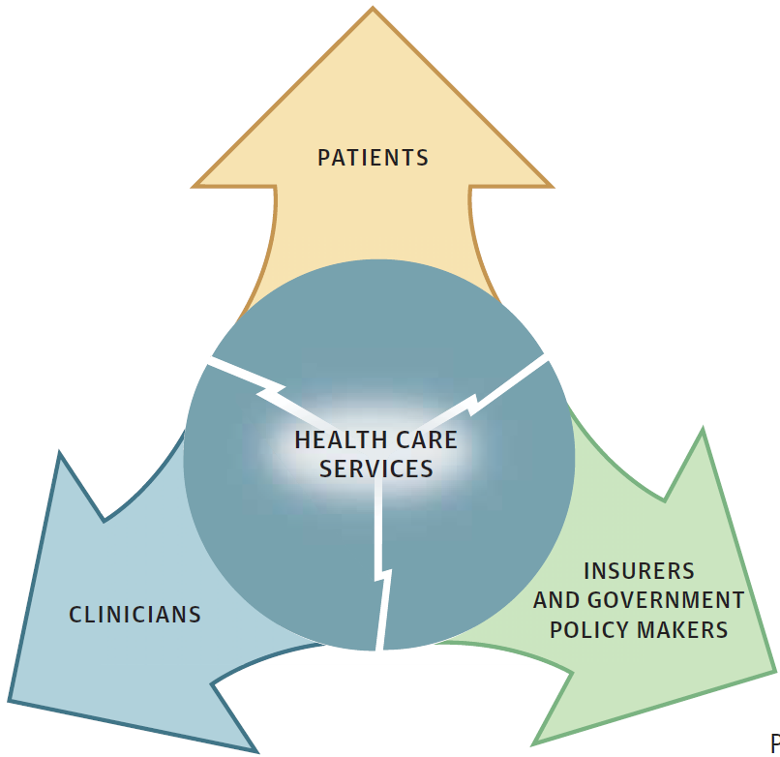
Lecture 1 recap:
Health system anatomy (financial and physical) has a huge influence in what data get generated
Cost (or disease burden) is a surrogate to help find important problems; ultimately, we are either risk stratifying or guiding treatment choice.
There is an inherent tension among the goals of the primary constituents (patients, providers, payers)
Notes:
Big Data plays a role in both the science of medicine (i.e. biomedical research) and in the practice / operations of medicine (i.e. healthcare)
What is great for the science of medicine (e.g. understanding the causation of cancer, heart defects etc) is not always directly useful for the practice of medicine (e.g. what to do for Mr. John Smith, with colon cancer). For a superb example of this "gap" between the science and the practice, see Alice Whittemore's talk on this last year http://bigdata.stanford.edu/event-videos/2013/page/2/ .. last video. Using breast cancer testing as an example, she argues brilliantly how not everything that advances the science of medicine also advances the practice. Of course, we as researchers live by advancing the science but Alice makes a great point. There is also the debate around pharmacogenomics.
Big Data has a role to make the practice of medicine better asap (example) and has the promise of advancing the science of medicine in the future.
There are areas of activity that are at the intersection of the practice and the science (e.g. the PheWas efforts).

Slide 3
Learning goals
What are the kinds of questions that we want answered? (slide 4 – 9)
What are the different study designs that can be used to answer them? (slide 10 – 20)
Slide 20 = how research questions and study designs related
How do we design studies to avoid bias? (slide 22 – 27)
What is a useful study? (slide 28 – 30)

Slide 4
Example Questions
What are the subtypes of autism?
What proportion of the US population has familial hyperlipidemia?
How does androgen deprivation increase dementia Risk?
Can we predict which patients will be high-cost in the next year?
Is mitral valve repair or replacement better for patients with prolapse?
Is there a relationship between gut bacteria and depression?
Notes:
Each of these types of analysis has a different goal and the results can be used in different ways

Slide 5
Think of a question
Take one minute to think of a potential clinical research question
Save this question; we will use it soon.
Notes:
Get them to as

Slide 6
Understanding the question
What proportion of the population has familial hyperlipidemia?
No
Did you interpret the summary created?
Yes
What are the subtypes of autism?
Is there a relation between gut bacteria and depression?
Which patients will be high-cost next year?
Is mitral valve repair or replacement better for patients with prolapse?
How does androgen deprivation increase dementia Risk?
Notes:
it’s important to practice categorizing questions into these categories
Do this for the

Slide 7
Understanding research questions helps you pin down your own aims and assess what others attempted, and whether they succeeded.

Slide 8
Breakout: What kind of question is it?
Pick one question among the members of your group and decide which kind of research question it is.
Notes:
Is hospital construction associated with invasive mold infections? (inferential)
For immunocompromised patients, does transfer to construction-free wards or hospitals avert mold infections? (causal)

Slide 9
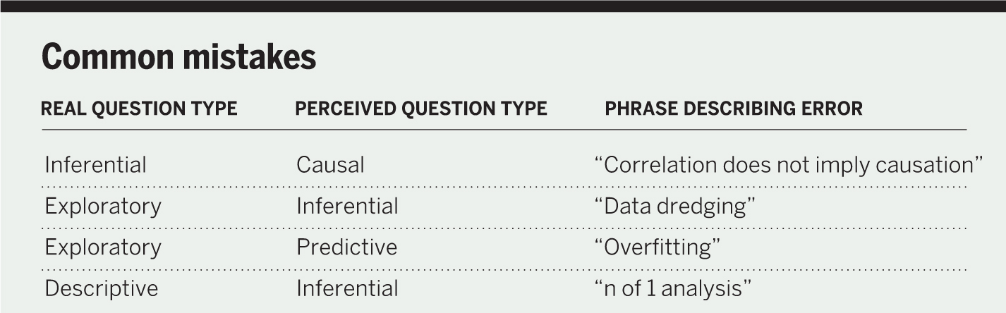

Slide 10
Study Designs in Clinical Research
case/control
observational study
randomized controlled trial
cohort study
prospective
Notes:
How are these things all related?
sometimes you can’t make a study design match the categories/descriptions in slide 10/slide 14, don’t stress too much about making it match exactly!

Slide 11
Studies of Patients: Exposures and Outcomes
an exposure
an outcome
patient
timeline
Are this exposure and outcome associated?
What exposures predict this outcome?
Does this exposure cause this outcome?

Slide 12
Controlled Assignment (Random)
patient
timeline

Slide 13
Uncontrolled Assignment (observational)

Slide 14
clinical study
The researcher does not interfere with the world. Subjects self-select into comparator groups.
The researcher interferes with the world. Subjects are split up into comparator groups by a known mechanism (e.g. coin flip).
observational
experimental
All data are collected at one point in time.
Measurements are taken over time.
cross-sectional
longitudinal
The groups being compared are defined based on what ended up happening at the end of the study (the outcome)
case-control
cohort
The groups being compared are defined based on what happened to them at the beginning of the study (the treatment, or exposure).
retrospective
prospective
more bias
less cost
survey
study design
RCT
more cost less bias
Notes:
sometimes you can’t make a study design match the categories/descriptions in slide 10/slide 14, don’t stress too much about making it match exactly!

Slide 15
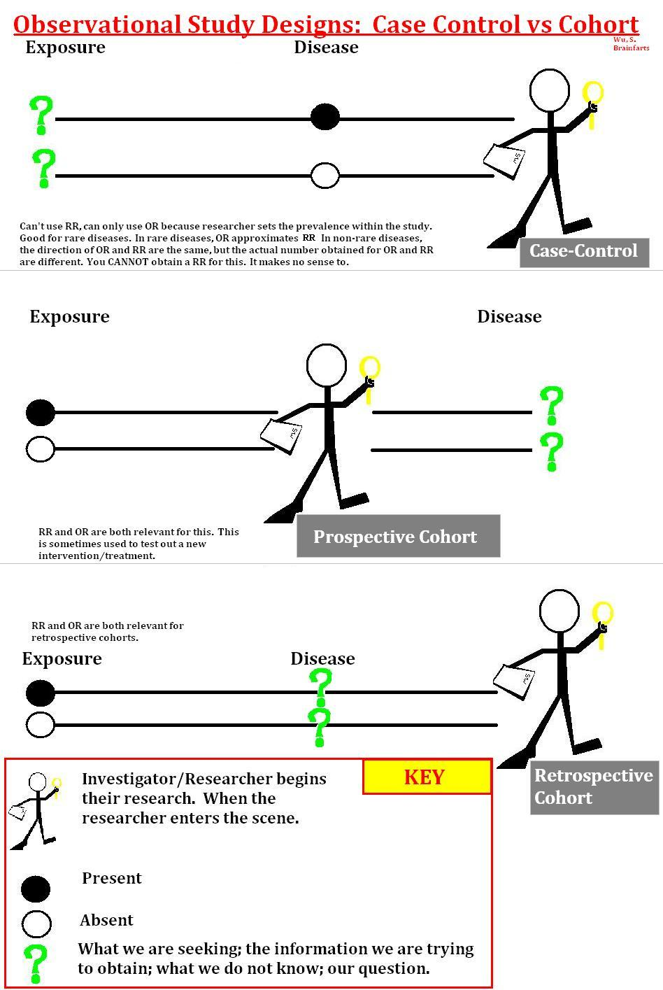
longitudinal
case-control
cohort
What counts as ‘not having’ the outcome?
retrospective
prospective
Notes:
Better power for rare outcomes

Slide 16
longitudinal
case-control
cohort
retrospective
prospective
What counts as not having the exposure?
Notes:
Better control for bias

Slide 17
clinical study
The researcher does not interfere with the world. Subjects self-select into comparator groups.
The researcher interferes with the world. Subjects are split up into comparator groups by a known mechanism (e.g. coin flip).
observational
experimental
All data are collected at one point in time.
Measurements are taken over time.
cross-sectional
longitudinal
The groups being compared are defined based on what ended up happening at the end of the study (the outcome)
case-control
cohort
The groups being compared are defined based on what happened to them at the beginning of the study (the treatment, or exposure).
retrospective
prospective
The data are collected for other purposes and are reused for research.
The data are collected in real time expressly for the purpose of the study.
more bias
less cost
survey
study design
RCT
more cost less bias

Slide 18
What kind of study is this?
We analyzed the electronic medical records of 1.8 million subjects from the Stanford clinical data warehouse.
We identified 232 PAD patients taking Cilostazol and created a control group of 1,160 PAD patients not taking this drug.
Over a mean follow up of 4.2 years, we observed no association between Cilostazol use and any major adverse cardiovascular events.
Take 1 min, and write down your answer
Notes:
for hw0: http://sphweb.bumc.bu.edu/otlt/MPH-Modules/EP/EP713_Bias/EP713_Bias7.html#headingtaglink_1

Slide 19
clinical study
observational
experimental
cross-sectional
longitudinal
case-control
cohort
retrospective
prospective
more bias
less cost
survey
study design
RCT
more cost less bias
Notes:
What do you believe is the most common study type?

Slide 20
Understanding study design allows you to quickly identify and address potential biases in your work and that of others.

Slide 21
Research questions and Study designs
clinical study
observational
experimental
cross-sectional
longitudinal
case-control
cohort
Causal and Mechanistic
Descriptive and Exploratory
retrospective
prospective
Inferential and Predictive
Notes:
The less prone to bias a study is, the more likely it will be able to confidently address harder questions

Slide 22
I have “Big Data” – what could possibly go wrong?
Everyone who got the disease is correctly labeled as such, everyone who got exposed is correctly labeled as such
 | disease (outcome) | no disease
exposed (treatment)
not exposed
Notes:
Exposure/Treatment Misclassification: incorrect labeling of who got the exposure and who didn’t in one or both of the disease groups
Disease/Outcome Misclassification: incorrect labeling of who got the disease and who didn’t in one or both of the exposure groups

Slide 23
The most important decision you will make is about who to include as the “not exposed”
We will discuss this in detail during the lectures on Associative Analyses
Notes:
Use examples from Jordan Ellenberg

Slide 24
Biases in Case-Control Studies
Self-Selection Bias: increased likelihood of sampling from a particular group (e.g. sick exposed people more likely to participate in study)
Control Selection Bias: The process for picking controls means more controls are likely to have been not exposed (e.g. controls are drawn from the community)
 | disease (outcome) | no disease
exposed (treatment)
not exposed
 | disease (outcome) | no disease
exposed (treatment)
not exposed

Slide 25
Biases in Cohort Studies
Loss to Follow-Up Bias: people who didn’t get the treatment have less interaction with the health system and are less likely to follow up, so their disease goes unobserved
Recording Bias: the exposure is more likely to have been recorded if the disease is likely (e.g. if the doctor suspects the patient could get lung cancer, they are more likely to ask if they smoke)
 | disease (outcome) | no disease
exposed (treatment)
not exposed
 | disease (outcome) | no disease
exposed (treatment)
not exposed
Notes:
Question: Can self-selection bias occur in prospective cohort studies?
No, because at the time of enrollment into a prospective cohort study nobody knows who will get the outcomes, and they are all part of the same cohort with common eligibility criteria, i.e., the entire cohort may be healthier than the general population. However, the comparison group is an internal one. It comes from the same healthy cohort. Consequently, if healthy people are more likely to volunteer for a cohort study, one might question whether the results are applicable to the broad population (external validity or generalizability), but at least for the study population the measure of association will not be biased the internal validity is ok.
Question: Why are cohort studies not prone to control selection bias?
the sampling is done based on exposure, which happens before disease, so you don’t have the ability to select those who are called the controls in case-control studies

Slide 26
Who counts as “not exposed”?
“Control group”
Changes the research question subtly
Usually where bias comes in
Notes:
Question: Can self-selection bias occur in prospective cohort studies?
No, because at the time of enrollment into a prospective cohort study nobody knows who will get the outcomes, and they are all part of the same cohort with common eligibility criteria, i.e., the entire cohort may be healthier than the general population. However, the comparison group is an internal one. It comes from the same healthy cohort. Consequently, if healthy people are more likely to volunteer for a cohort study, one might question whether the results are applicable to the broad population (external validity or generalizability), but at least for the study population the measure of association will not be biased; the internal validity is ok.
Question: Why are cohort studies not prone to control selection bias?
the sampling is done based on exposure, which happens before disease, so you don’t have the ability to select those who are called the controls in case-control studies

Slide 27
It is known that smoking increases the risk of emphysema.
Let’s say we do a prospective cohort study of smoking and emphysema but find no association. Describe a bias that might be at play in our study.
tip: consider the question in terms of who we could be over- or under-counting
Discuss with the person next to you
Draw the 2x2 table

Slide 28
Where does “Big Data” fit into this?
clinical study
rapid iteration
observational
low-cost
experimental
better cohort building
cross-sectional
longitudinal
detecting rare events
more power to detect subgroups
personalization
case-control
cohort
Causal and Mechanistic
new kinds of measurements
natural experiments
Descriptive and Exploratory
retrospective
prospective
Inferential and Predictive
Notes:
Almost all “big data” is retrospective by definition (exception would be point-of-care randomization)
big data primarily supports exploratory, inferential, and predictive analyses

Slide 29
When designing or reading a study:
What is the goal of the analysis? What kind of question is being asked?
What is the appropriate study design for this question? What are the potential biases and how can they be addressed?
Are these the right data to use?
Will the results of the study be relevant and useful? (and to whom)

Slide 30
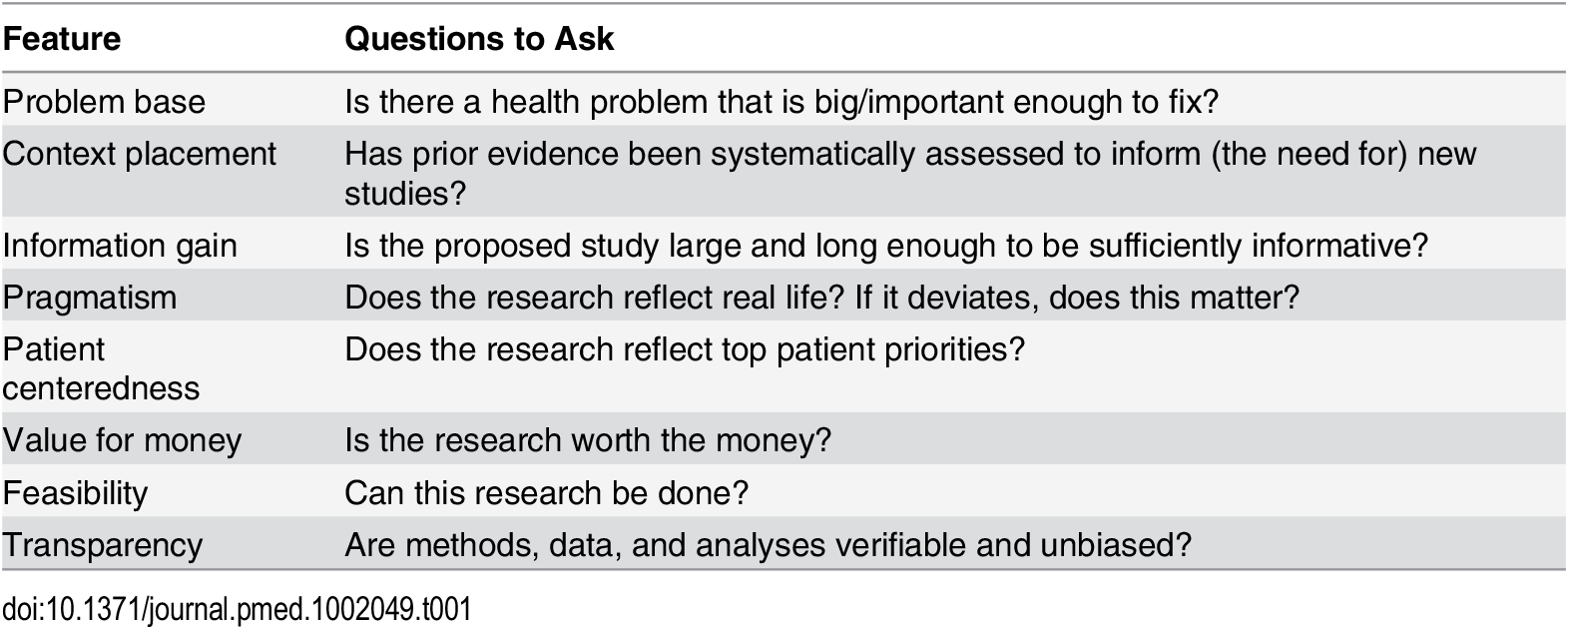
What combinations of research questions, study designs, and data are worthwhile?

Slide 31
Optional reading
Ioannidis JPA
Why Most Clinical Research Is Not Useful.
PLOS Medicine 13(6): e1002049. https://doi.org/10.1371/journal.pmed.1002049
Lecture Review Survey is up on Canvas

